Slide 1
Introduction on FHIR
By Dr Elisavet Andrikopoulou

Slide 2


Introduction
I am Dr Elisavet Andrikopoulou, senior lecturer at University of Portsmouth.
My team and I won the first Hack day of collaboration from MCBK-UK and NICE.
I lead a FHIR - CQL project for creating libraries of reusable code. If you want to learn more about it, please use this link.
My email: elisavet.andrikopoulou@port.ac.uk

Slide 3

Agenda
FHIR concepts
FHIR definition
FHIR server API
FHIR “Jane Doe” quick and dirty ;)
FHIR resources & discussion
Please click on the repository to find all sample code and examples of both FHIR and CQL.

Slide 4

The story of FHIR
HL7 has some interesting questions on their website:
Fast Healthcare Interoperability Resources
Developed by HL7
“Founded in 1987, Health Level Seven International (HL7) is a not-for-profit, ANSI-accredited standards developing organization dedicated to providing a comprehensive framework and related standards for the exchange, integration, sharing and retrieval of electronic health information that supports clinical practice and the management, delivery and evaluation of health services.”

Slide 5
FHIR fundamental concepts
Query retrieve – search
Distributed data (distributed databases including cloud)
Answering questions not providing pdf!
Focus on interoperability
Suitable for both large EHRs and small home or mobile devices
Future basis for clinical decision support systems
FHIR is defined here.
For more on FHIR this is a free tutorial.

Slide 6
FHIR
Common open-source implementation available: HAPI-FHIR, FirelyTeam, SMART on FHIR client
The server we use is the FHIR Hapi public server.
link: https://hapi.fhir.org/home?serverId=home_r4&pretty=true&_summary=&resource=
Tutorial - Using Postman for CRUD operations on FHIR - https://github.com/FirelyTeam/fhirstarters/blob/master/postman/crud/README.md
Public FHIR server examples: http://hapi.fhir.org/baseR4/Observation/f70d7f58-4d2f-472c-bfdc-4f8dafef4f7d
http://hapi.fhir.org/baseR4/Library/anc-recommendation-a2

Slide 7
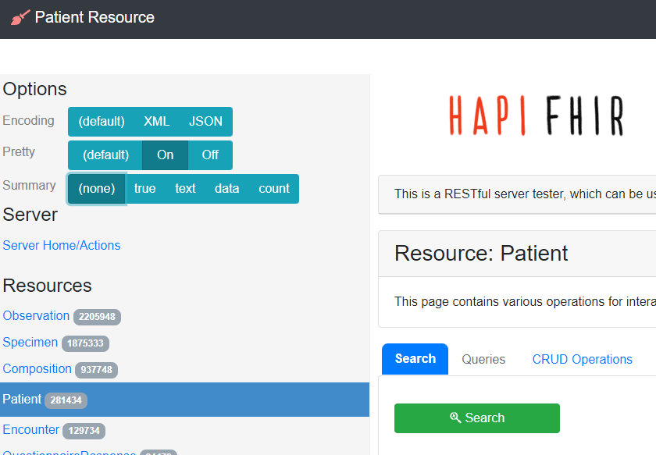
FHIR “Jane Doe”
Go to patient tab and select search

Slide 8
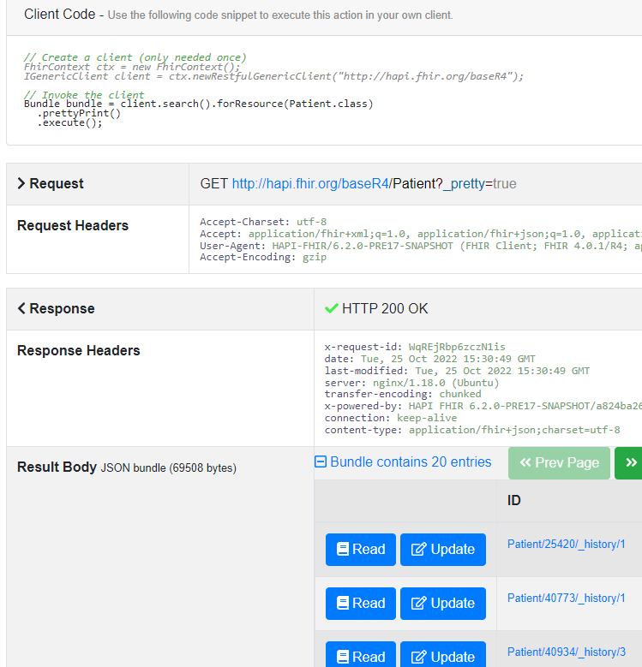
FHIR “Jane Doe”
Note the HAPI generated http request and headers.
The response body is a FHIR “bundle”.
Select one of the Patient resources from the bundle.
Click Read

Slide 9
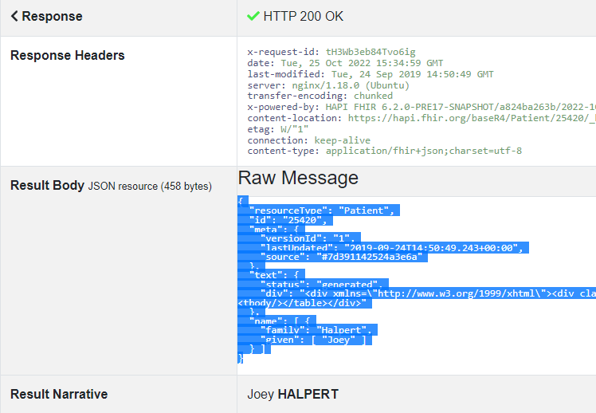
FHIR “Jane Doe”
Copy the whole JSON response body to the clipboard (Ctrl-C).
Go back to the
Patient resource
page (slide 8).

Slide 10
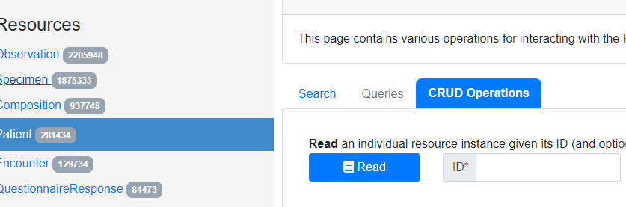
FHIR “Jane Doe”
Select CRUD operations.
CRUD stands for Create, Read, Update, Delete.

Slide 11
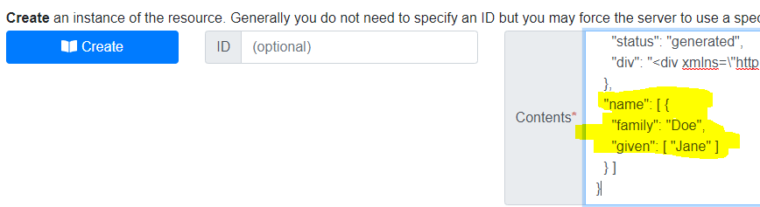
FHIR “Jane Doe”
Paste the JSON into the Contents field by Create.
Edit the “family” and “given” elements of “name”.
Click Create.

Slide 12
FHIR “Jane Doe”
If it works, you should get HTTP 201 Created.
If it doesn’t work, double check your JSON using the VALIDATE crud operation
Task:
Can you find the patient with ID 7044561?
What is their name?

Slide 13
Sample FHIR Patient
This is a short version of the patient at this link.
edit the “id”, “gender” and “birthDate” properties as you wish
Paste this into the Contents field and click Create.
{"resourceType": "Patient",
"id": "777000333",
"name":
[{"use": "official",
"family": "Love",
"given": ["CQL"]}],
"gender": “female",
"birthDate": "1992-01-15"
}

Slide 14
More FHIR Resources
Hapi FHIR: https://hapifhir.io/hapi-fhir/docs/introduction/table_of_contents.html
Another resource for learning about Hapi FHIR:
https://www.youtube.com/watch?v=pNprqpwGldE
Firely FHIR server: https://fire.ly/
Github for Firely: https://github.com/FirelyTeam/fhirstarters/tree/master/java/hapi-fhirstarters-client-skeleton/
FHIR in java example:
https://community.intersystems.com/post/simple-example-fhir-client-java
FHIR with postman tutorial: https://learn.microsoft.com/en-us/azure/healthcare-apis/fhir/use-postman

